Slide 1
AtliQ Hardware — Data-Driven Insights from Ad-Hoc Analysis
SQL-Based Business Insights for Executive Decision-Making
Trey Wright Presenting

Slide 2
Introduction
About AtliQ Hardware:
-A top-tier hardware manufacturer expanding across 27 global markets.
Business Challenge:
-Lack of real-time insights for strategic planning.
Objective:
-Empower leadership with data-informed insights via SQL analysis.

Slide 3
AGENDA
Project Objective
Business Questions & Insights
Key Takeaways
Strategic Recommendations

Slide 4

Executive Summary
Growth: Unique product portfolio expanded by 36%, driving fresh revenue.
Seasonality: Q1 (Sep-Nov) is our "Make or Break" window, accounting for significant volume.
Risk: Reliance on Retailers (73%) and deep discounting (>30%) requires immediate diversification.
Notes:
To address risks and capitalize on growth, it is recommended to allocate more marketing resources to Direct-to-Consumer channels. Additionally, inventory should be ramped up well before the critical Q1 sales period to meet demand. Pricing policies for major customers need review to ensure high volume sales do not erode profitability.

Slide 5
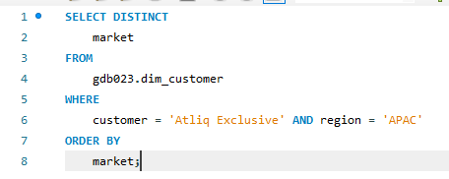
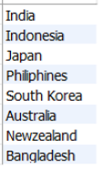
01
In which APAC countries does the customer 'AtliQ Exclusive' operate?
AtliQ Exclusive operates in 8 key APAC markets, with India leading in gross sales.

Slide 6
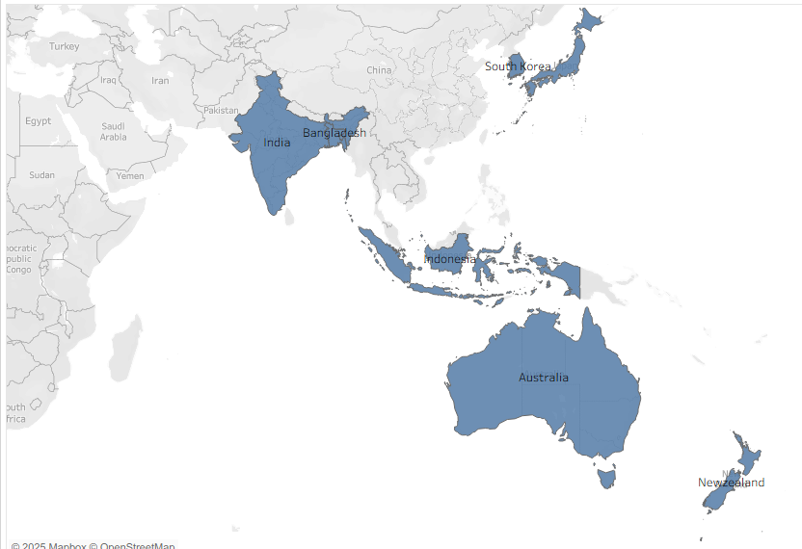
01
In which APAC countries does the customer 'AtliQ Exclusive' operate?
This indicates strong regional engagement, ideal for targeted marketing campaigns or expansion.

Slide 7
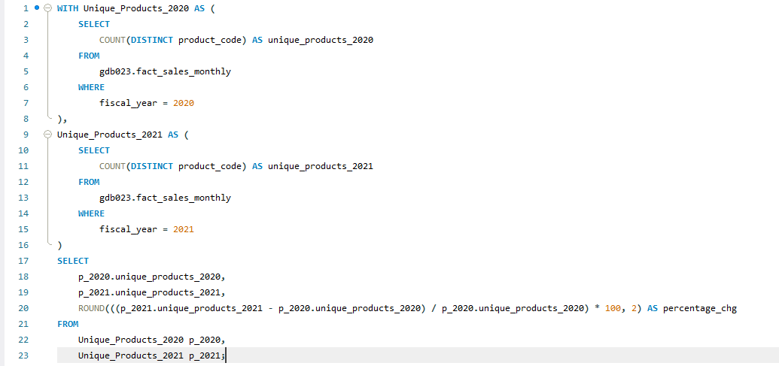

02
How many new unique products were introduced in 2021 compared to 2020?
Unique product offerings grew by 36.33%, signaling a broadened product catalog.

Slide 8
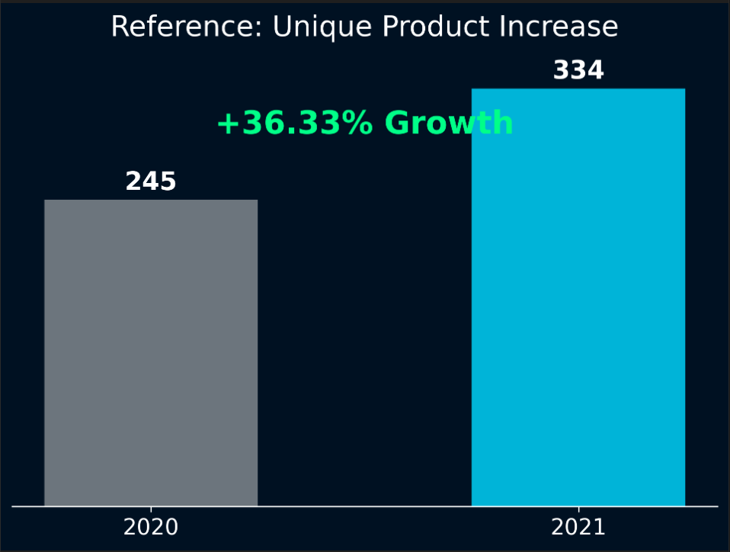
02
How many new unique products were introduced in 2021 compared to 2020?
Unique product offerings grew by 36.33%, signaling a broadened product catalog.

Slide 9
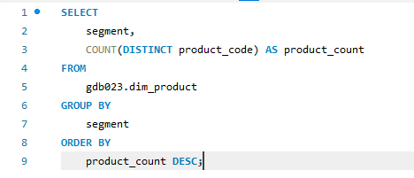
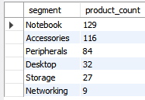
03
Which segments have the highest number of unique products?
Unique product offerings grew by 44%, signaling a broadened product catalog.

Slide 10
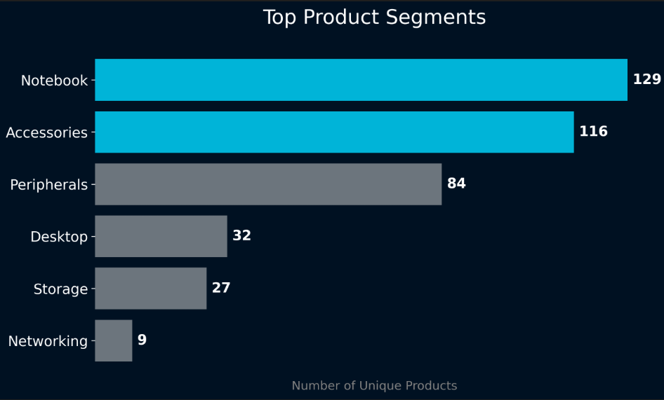
03
Which segments have the highest number of unique products?
Unique product offerings grew by 44%, signaling a broadened product catalog.

Slide 11
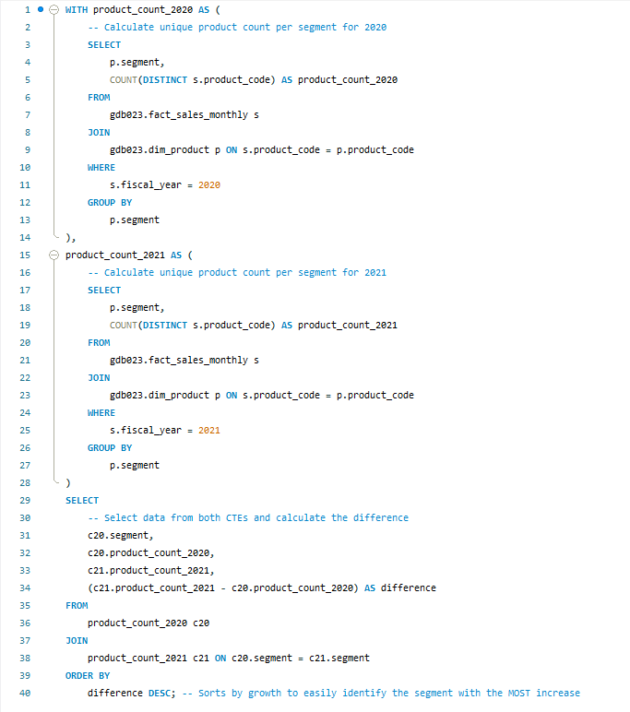
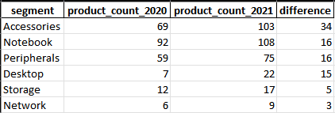
04
Which segment saw the most growth in unique products year-over-year?
Compared distinct product counts by segment for 2020 and 2021, calculated differences.

Slide 12
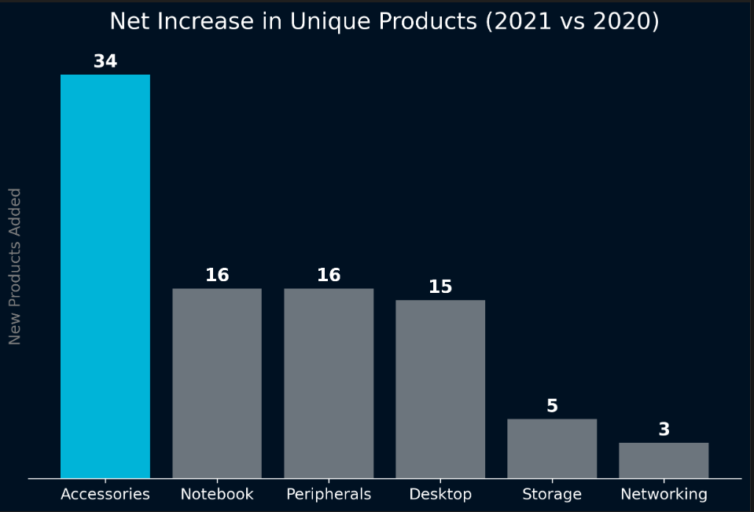
04
Which segment saw the most growth in unique products year-over-year?
Compared distinct product counts by segment for 2020 and 2021, calculated differences.

Slide 13
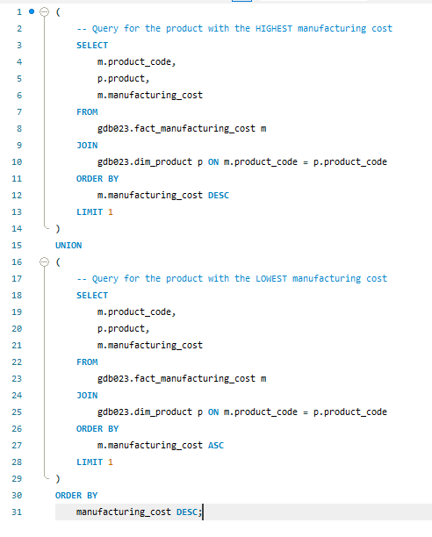

05
Which products had the highest and lowest manufacturing costs?
Selected products with max and min manufacturing costs from cost data.

Slide 14
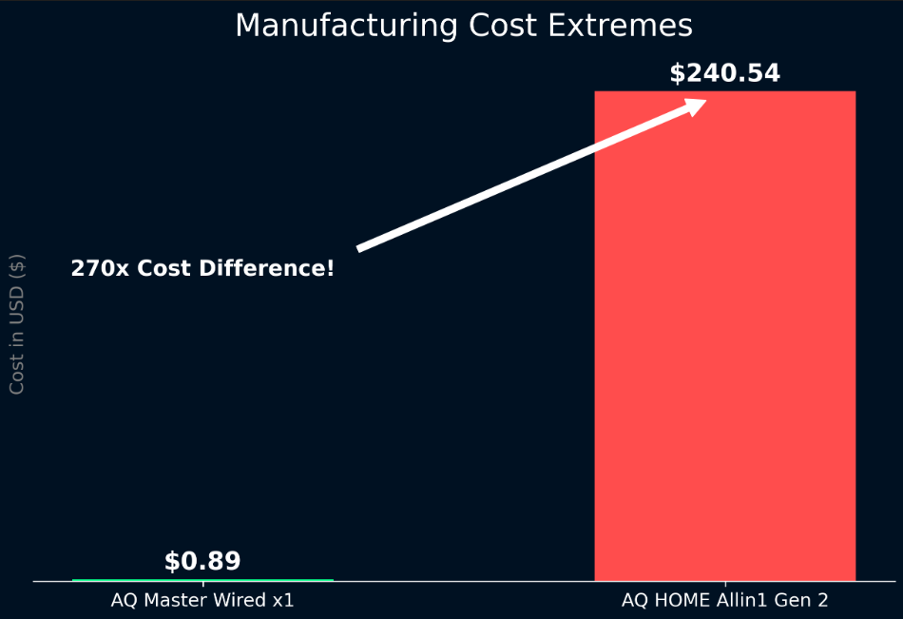
05
Which products had the highest and lowest manufacturing costs?
Selected products with max and min manufacturing costs from cost data.

Slide 15
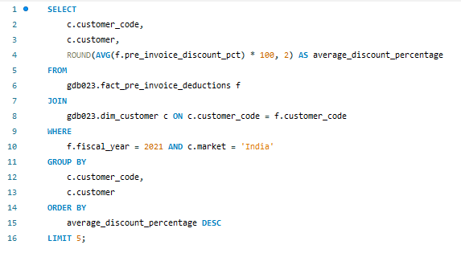
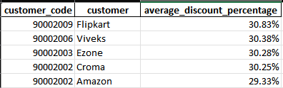
06
Who are the top Indian customers receiving the highest average pre invoice discounts in 2021?
Filtered Indian market data, grouped by customer, calculated average discounts, and sorted.

Slide 16
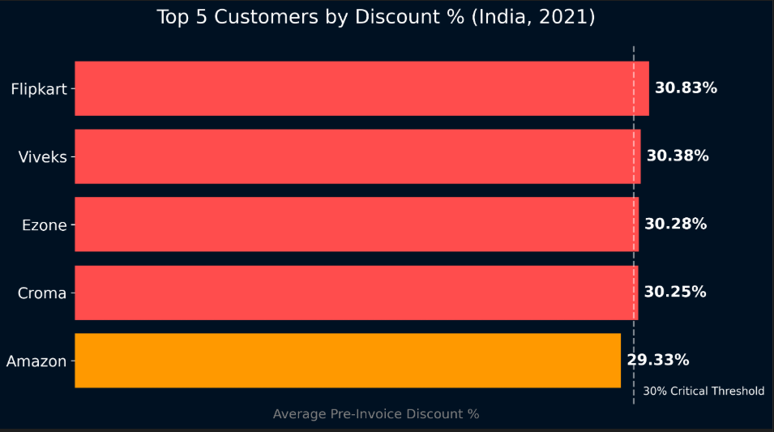
06
Who are the top Indian customers receiving the highest average pre invoice discounts in 2021?
Filtered Indian market data, grouped by customer, calculated average discounts, and sorted.

Slide 17
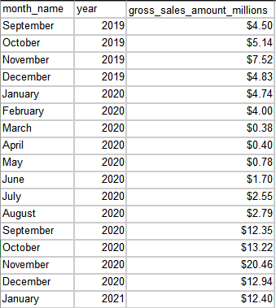
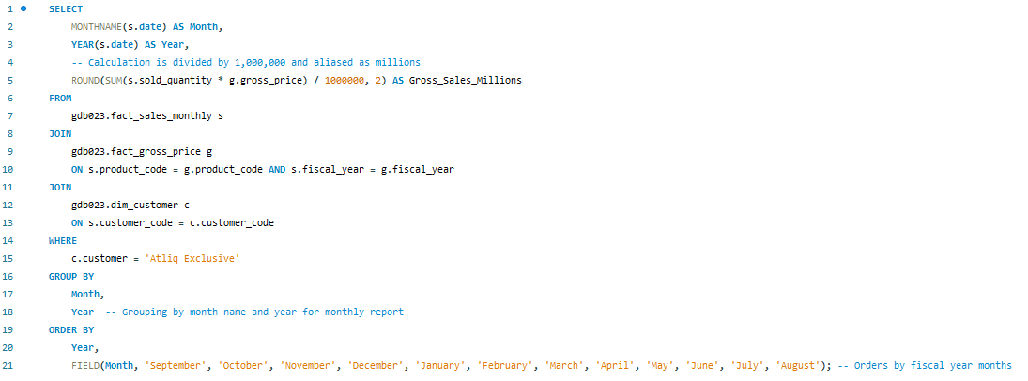
07
What were the monthly gross sales trends for AtliQ Exclusive?
Aggregated monthly sales for AtliQ Exclusive from fact tables.

Slide 18
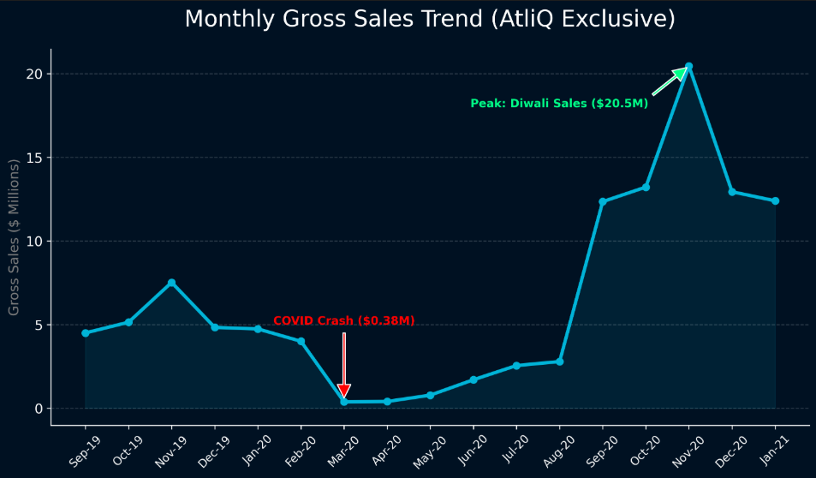
07
What were the monthly gross sales trends for AtliQ Exclusive?
Aggregated monthly sales for AtliQ Exclusive from fact tables.

Slide 19
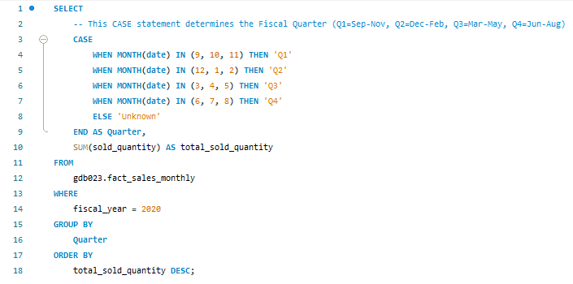
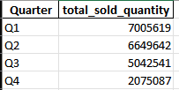
08
Which quarter in 2020 saw the highest quantity of products sold?
Grouped sales by quarter and summed quantities sold.

Slide 20
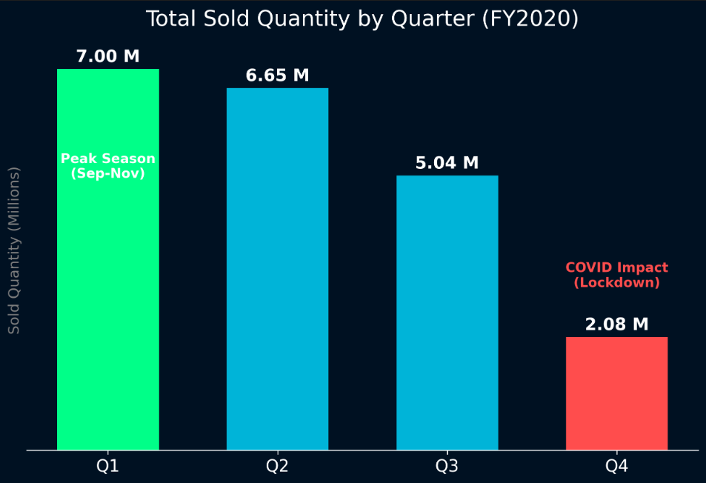
08
Which quarter in 2020 saw the highest quantity of products sold?
Grouped sales by quarter and summed quantities sold.

Slide 21
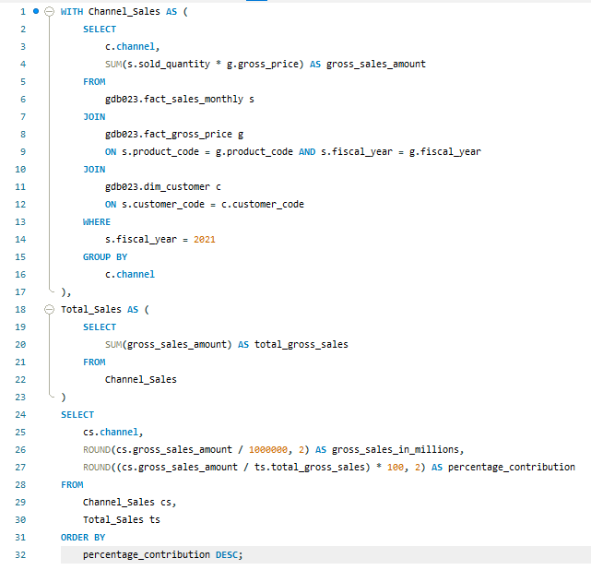

09
What is the contribution of each sales channel to total sales in 2021?
Grouped sales by channel and calculated gross sales and percentages.

Slide 22
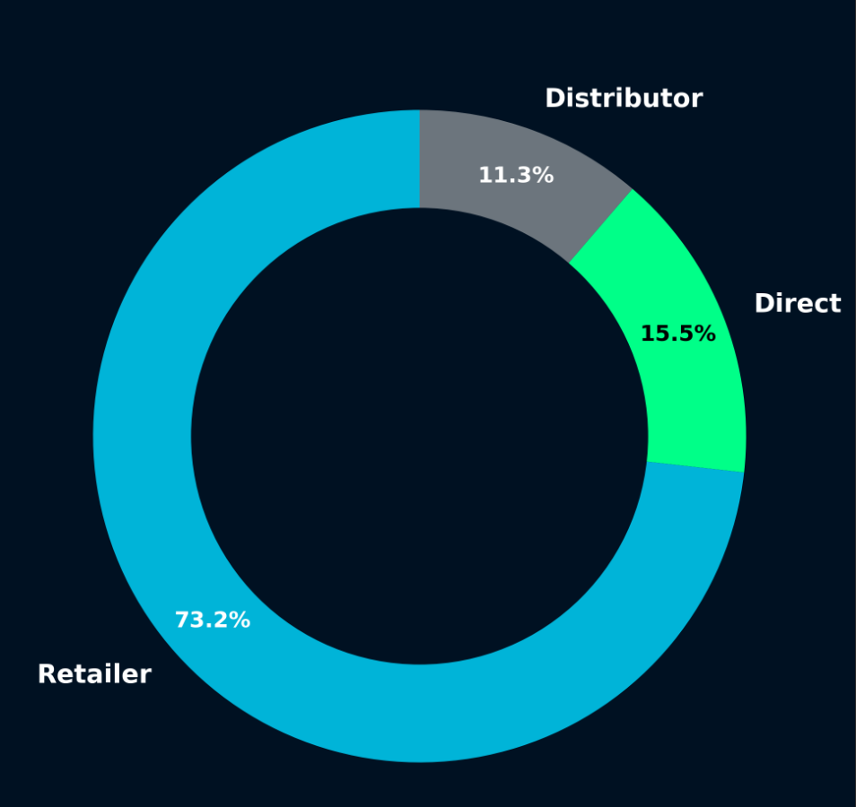
09
What is the contribution of each sales channel to total sales in 2021?
Grouped sales by channel and calculated gross sales and percentages.

Slide 23
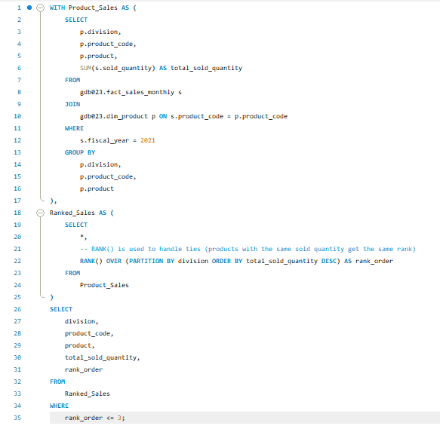
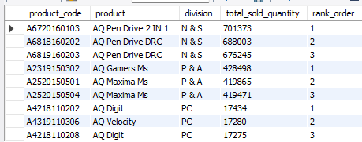
10
Which three products in each division sold the most units in 2021?
Grouped by division and product, sorted by quantity sold, and selected top 3 per division.

Slide 24
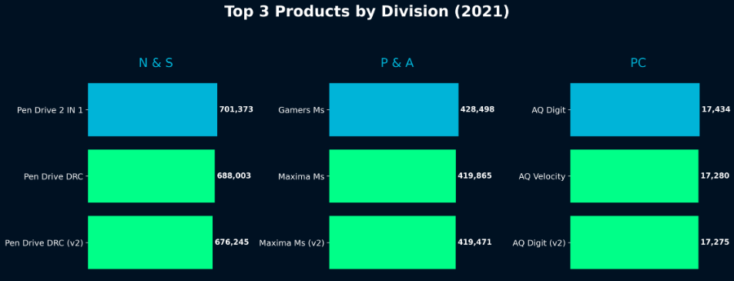
10
Which three products in each division sold the most units in 2021?
Grouped by division and product, sorted by quantity sold, and selected top 3 per division.

Slide 25
Strategic Recommendations
01
02
03
Diversify Sales Channels: Reduce impact of Retailer dominance by investing 15% more marketing budget into Direct-to-Consumer (DTC) channels.
Optimize for Q1: Ramp up inventory production in July-August to prevent stockouts during the critical Sep-Nov festive season.
Discount Control: Review pricing strategy for top customers (Flipkart, Viveks) to ensure high volume justifies the >30% discount margin erosion.

Slide 26
